Slide 1

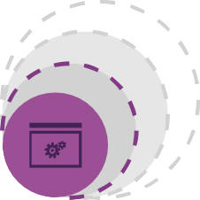


Azure Data Lake Store

Slide 2

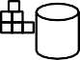

Modern Data Warehouse
INGEST
STORE
PREP & TRAIN
MODEL & SERVE
Logs (unstructured)
Azure Databricks
Media (unstructured)
PolyBase
Files (unstructured)
Azure Data Factory
Data Lake
Azure SQL Data Warehouse
Azure Analysis Services
Power BI
Business/custom apps
(structured)

Slide 3

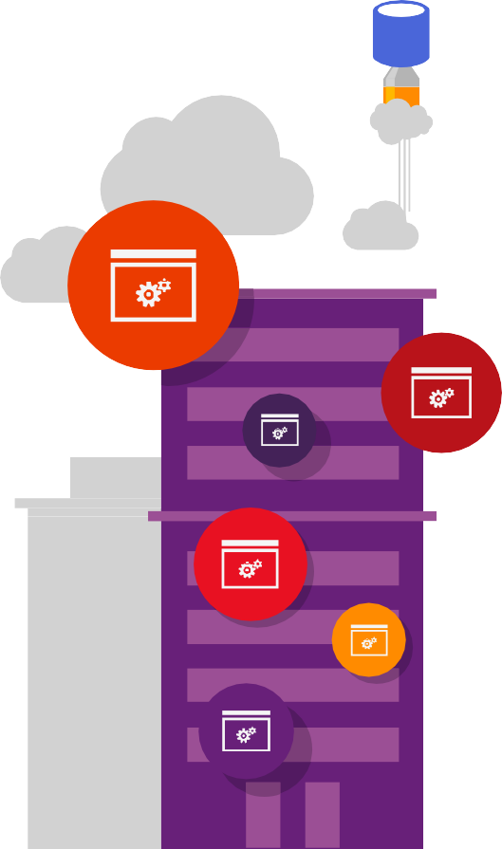

?
Why data lakes?
?
?
?

Slide 4













Traditional business analytics process
Start with end-user requirements to identify desired reports
and analysis
Define corresponding database schema and queries
Identify the required data sources
Create a Extract-Transform-Load (ETL) pipeline to extract required data (curation) and transform it to target schema (‘schema-on-write’)
Create reports. Analyze data
Relational
Dedicated ETL tools (e.g. SSIS)
ETL pipeline
Queries
LOB
Applications
Defined schema
Results
All data not immediately required is discarded or archived
4

Slide 5
New big data thinking: All data has value
All data has potential value Data hoarding
No defined schema—stored in native format
Schema is imposed and transformations are done at query time (schema-on-read).
Apps and users interpret the data as they see fit
Iterate
Store indefinitely
Analyze
Gather data
from all sources
See results
5

Slide 6

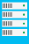
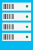



Data Lake Store: Technical Requirements
Secure
Must be highly secure to prevent unauthorized access (especially as all data is in one place).
Scalable
Must be highly scalable. When storing all data indefinitely, data volumes can quickly add up
Reliable
Must be highly available and reliable (no permanent loss of data).
Throughput
Must have high throughput for massively parallel processing via frameworks such as Hadoop and Spark
Details
Must be able to store data with all details; aggregation may lead to loss of details.
Native format
Must permit data to be stored in its ‘native format’ to track lineage & for data provenance.
All sources
Multiple analytic frameworks
Must be able ingest data from a variety of sources-LOB/ERP, Logs, Devices, Social NWs etc.
Must support multiple analytic frameworks—Batch, Real-time, Streaming, ML etc. No one analytic framework can work for all data and all types of analysis.
6

Slide 7






Big Data analytics workloads
A highly scalable, distributed, parallel file system in the cloud
specifically designed to work with a variety of big data analytics workloads
Devices
Azure Data Lake Analytics
Batch
U-SQL
LOB Applications
Web
HDInsight
Relational
Batch
MapReduce
NoSQL
HBase
Social
Azure Data Lake Store
Video
Script
Pig
In-Memory
Spark
Sensors
Clickstream
SQL
Hive
Predictive
R Server

Slide 8
Azure Data Lake Store Overview

Slide 9








Azure Data Lake (Gen1)
Analytics
HDInsight
U-SQL
(extensible by C#, R and Python)
YARN
WebHDFS
Store

Slide 10





WASB
WASB
ADLS
Azure Data Lake Storage Gen2
Blob Storage + (WASB)
Blob Storage + (WASB)
Azure Data Lake Store (ADLS)
Scalable, secure storage that
speeds time to insight
Scale and Availability
Scale and Availability
Speed to Insight
Scale and Availability
Speed to Insight
Cost Effectiveness
Cost Effectiveness
Rich Security
Cost Effectiveness
Rich Security
Azure Data Lake Storage Gen2: Single Data Lake Store that combines the performance and innovation of ADLS with the scale and rich feature set of Blob Storage

Slide 11
Azure Data Lake Storage Gen2 Key Features

Slide 12
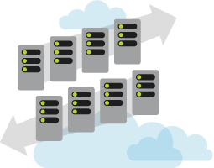
Azure Data Lake Store: no scale limits
Azure Data Lake Store integrates with Azure Active Directory (AAD) for:
Amount of data stored
How long data can be stored Number of files
Size of the individual files Ingestion throughput
Seamlessly scales from a few KBs to several PBs
15

Slide 13


ADL Store Unlimited Scale – How it works
Each file in ADL Store is sliced into blocks
Blocks are distributed across multiple data nodes in the backend storage system
With sufficient number of backend storage
data nodes, files of any size can be stored
Backend storage runs in the Azure cloud which has virtually unlimited resources
Metadata is stored about each file
No limit to metadata either.
Azure Data Lake Store file
Block 1
Block 2
…
Block 2
Block
Data node
Block
Data node
Block Block
Data node Data node
Block
Data node
Block
Data node
Backend Storage
16

Slide 14
ADL Store offers massive throughput
Read operation
Through read parallelism ADL Store provides massive throughput
Each read operation on a ADL Store file results
Azure Data Lake Store file
Block 1
Block 2
…
Block 2
in multiple read operations executed in parallel against the backend storage data nodes
Block
Block
Block
Block
Block
Block
Data node
Data node
Data node Data node
Backend storage
Data node
Data node
17

Slide 15

ADL Store: high availability and reliability
Write Commit Replica 1
Azure maintains 3 replicas of each data object per region across three fault and upgrade domains
Each create or append operation on a replica is replicated to other two
Writes are committed to application only after
all replicas are successfully updated
Read operations can go against any replica
Fault/upgrade domains
Replica 2
Replica 3
Data is never lost or unavailable even under failures
18

Slide 16





The building blocks
Ingestion, processing, egress, visualization, and orchestration tools

Slide 17












Ingestion tools – Getting started
Data on your desktop
Data located in other stores

Slide 18













Building pipelines - Management and orchestration
Out-of-the-box tools
Custom tools

Slide 19
Object Storage (Azure Blob Storage)
Flat storage space
Data represented as blobs
Highly scalable
Cost-Effective
File System Storage Azure Data Lake Storage Gen 1
Hierarchical storage space
Data is blocks in a file system
Security at folder/file levels
Atomic & metadata operations
or
Azure Data Lake Storage Gen 2
Get the features of file system storage
Get the cost/scale features of blob storage

Slide 20


Text Files!
Human readable
Standardized
Well supported
.txt, .csv, etc.
JSON
Human readable
Supports complex nesting
Files can be large without compression

Slide 21



Two-part file format
Binary portion for data
JSON-based schema
Supports schema evolution
Requires a custom viewer utility

Slide 22



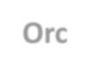

Parquet
Orc
From Hortonworks/Facebook
From Cloudera/Twitter
Both support compression and predicate pushdown
Writes are slower in both due to columnar format

Slide 23
Generally better for analytical workloads
Test your workload!
May be worth the effort if
Querying data multiple times
Need predicate pushdown or column elimination
Can reduce/eliminate encoding issues with delimited formats

Slide 24



Slide 25




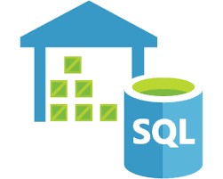
U-SQL

Slide 26


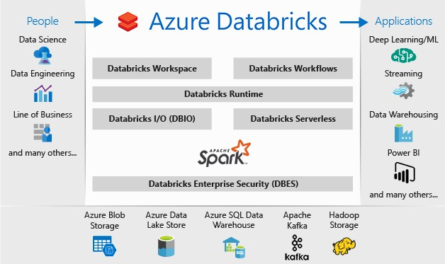
Cloud-based analytics platform based on Spark
Image: Microsoft

Slide 27




The native language of Azure Data Lake Analytics (ADLA)
A combination of SQL and C#
Can be executed in the cloud, or locally

Slide 28
@dataset =
EXTRACT UserID
StartDT URL
INT, DATETIME, STRING
FROM @”/datafile.tsv” USING Extractors.Tsv();
OUTPUT @dataset
TO @”/datafile_output.tsv” USING Outputters.Tsv();

Slide 29


An ETL/Query tool that runs on top of Hadoop
Has its own query language – HiveQL or HQL
Very similar to SQL
SELECT plate_number, COUNT(*) FROM Tickets;

Slide 30
Data streams in over time, is batched, and gets processed
Data Sources
Data Storage
Blob Storage
Data Lake
SQL Database
Cosmos DB
Batch Processing
U-SQL
Hive
Pig
Spark
Analytics & Reporting
Analytical Data Store
SQL DW
Spark SQL
HBase
Hive
Real-Time Message Ingestion
Stream Processing
Orchestration
Data Factory
HDInsight

Slide 31
Data streams in and is processed in near real-time
Data Sources
Data Storage
Batch Processing
Analytical Data Store
SQL DW
Spark SQL
HBase
Hive
Analytics & Reporting
Stream Processing
Stream Analytics
Storm
Spark Streaming
Ingestion
Event Hub
IoT Hub
Kafka
Orchestration

Slide 32
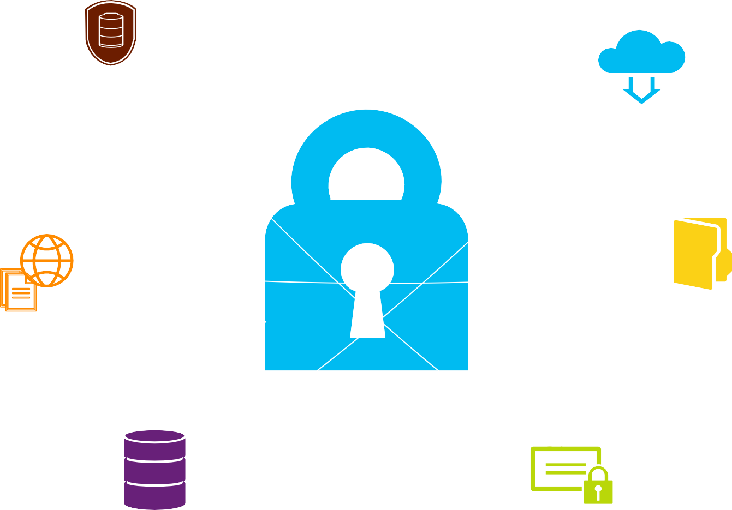
Security

Slide 33







Security features
Identity Management & Authentication
Access Control & Authorization
Auditing
Data Protection & Encryption

Slide 34

ADL Store Security: AAD integration
Multi-factor authentication based on OAuth2.0
Integration with on-premises AD for federated authentication Role-based access control
Privileged account management
Application usage monitoring and rich auditing Security monitoring and alerting
Fine-grained ACLs for AD identities
25

Slide 35
Authentication through Azure Active Directory
Roles for account management
POSIX ACL for data access
Unix-style read/write/execute permissions
ACLs can be enabled on folders or individual files
Permissions cannot be inherited from a parent object
Security groups also exist, can assign users to groups & grant that way

Slide 36
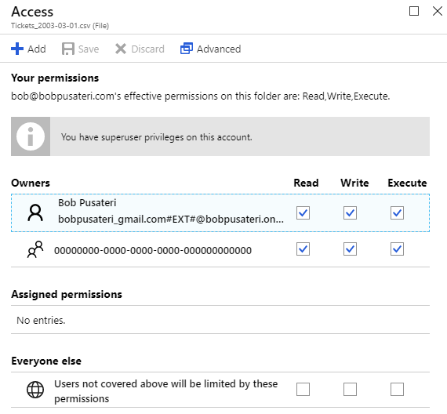
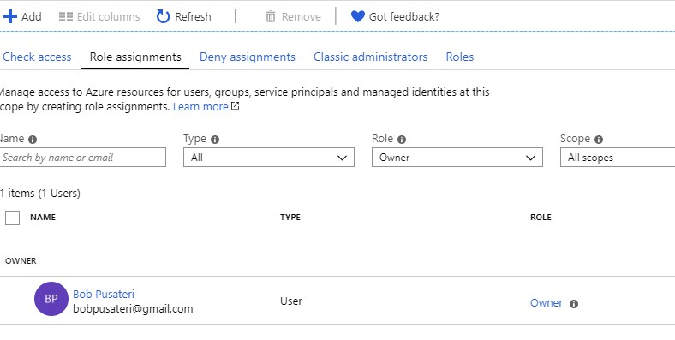

Slide 37
Can enable a firewall
Only IP addresses in a defined range can access ADL
Encryption
Can enable encryption before data is written on disk
TLS 1.2 for data in motion

Slide 38
Builds on security available in ADL Gen 1
RBAC has been extended into container resources
Shared Key and Shared Access Signature Authentication
Shared Keys grant super user access
SAS tokens include permissions
Inheritance (limited)
Objects can inherit permissions from parent objects if default permissions were set on parent objects ahead of time

Slide 39
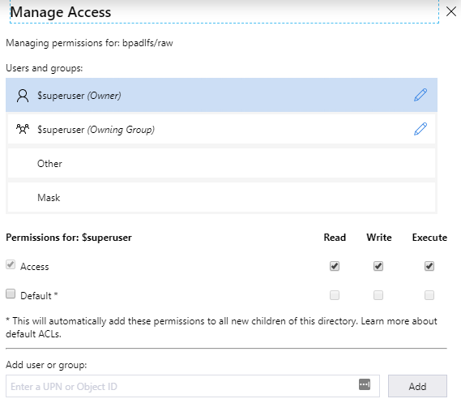

Slide 40



Slide 41




You Pay For:
Storage ($0.039 per GB/month)
Operations
Reads ($0.05 per 10,000)
Writes ($0.004 per 10,000)
Outbound data transfers (varies by region)
North Central US: $0.087 per GB
Additional storage savings with monthly commitments
Check Azure Portal for most current pricing info
https://azure.microsoft.com/en-us/pricing/details/data-lake-storage-gen1/

Slide 42


Prices very based on flat/hierarchical structure & storage tier
Storage ($0.0208/0.0152/0.002 per GB/month)
Operations
Reads ($0.0052/0.013/6.50 per 10,000)
Writes ($0.065/0.13/0.13 per 10,000)
Outbound data transfers (varies by region)
North Central US: $0.087 per GB
Check Azure Portal for most current pricing info
https://azure.microsoft.com/en-us/pricing/details/storage/data-lake/

Slide 43




Run U-SQL locally on your machine for free
https://docs.microsoft.com/en-us/azure/data-lake-analytics/data-lake- analytics-data-lake-tools-local-run

Slide 44



Slide 45


Chicago Parking Tickets Data:
https://www.bobpusateri.com/archive/2018/09/new-data-set-chicago-parking-tickets/
Melissa Coates has lots of good blog posts: https://www.sqlchick.com/entries/tag/Azure+Data+Lake
Run U-SQL Locally:
https://docs.microsoft.com/en-us/azure/data-lake-analytics/data-lake-analytics-data-lake-tools-local-run
U-SQL Tutorial: https://saveenr.gitbooks.io/usql-tutorial/content/
Querying Data in Azure Data Lake with Power BI: https://www.sqlchick.com/entries/2018/5/6/querying-data-in-azure-data-lake-store-with-power-bi
10 Things to know about Azure Data Lake Storage Gen2:
https://www.blue-granite.com/blog/10-things-to-know-about-azure-data-lake-storage-gen2

